Slide 1

Foundations of Employee Motivation
Copyright © 2015 McGraw-Hill Education. All rights reserved. No reproduction or distribution without the prior written consent of McGraw-Hill Education.

Slide 2
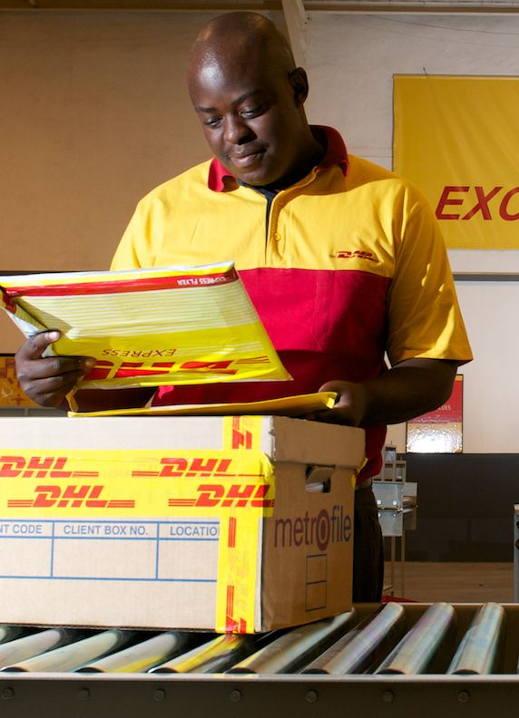
Employee Engagement and Motivation at DHL Express
DHL Express, the courier division of Germany’s Deutsche Post, has been building a workforce of highly engaged employees in Africa (shown here) and globally. “Motivated and engaged employees are crucial to the success of any business,” says a DHL Express executive.

Slide 3
Motivation Defined
The forces within a person that affect the direction, intensity, and persistence of voluntary behavior
Motivated employees are willing to exert a particular level of effort (intensity), for a certain amount of time (persistence), toward a particular goal (direction)

Slide 4
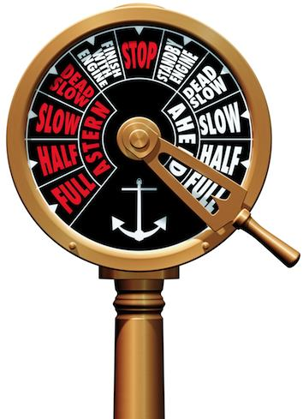
Employee Engagement
Both emotional and cognitive motivation
Focused, intense, persistent, purposive effort toward goals
High level of absorption (focus)
High self-efficacy

Slide 5
Drives and Needs
Drives (primary needs)
Hardwired brain activity (neural states) that energize individuals through generation of emotions to correct deficiencies and maintain equilibrium
Prime movers of behavior -- activate emotions that put us in a state of readiness
Self-concept, social norms, and past experience
Drives
and Emotions
Needs
Decisions and Behavior

Slide 6
Drives and Needs
Needs
Goal-directed forces that people experience.
We channel emotional forces toward specific goals
Goals formed by self-concept, social norms, and experience
Self-concept, social norms, and past experience
Drives
and Emotions
Needs
Decisions and Behavior

Slide 7
Maslow’s Needs Hierarchy Theory
Seven categories – five in a hierarchy -- capture most needs
Lowest unmet need is strongest -- when satisfied, next higher need becomes primary motivator
Model lacks empirical support
Main problem: Needs hierarchy is unique to each person, not universal
Self-actual-ization
Need to
know
Need for beauty
Esteem
Belongingness
Safety
Physiological

Slide 8
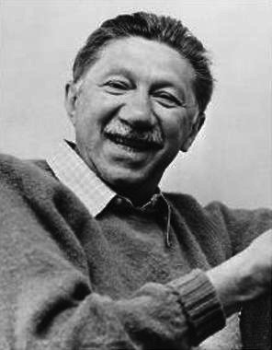
Maslow’s Contribution to Motivation
Holistic perspective
Study multiple needs together
Humanistic perspective
Influence of social dynamics, not just instinct
Positive perspective
Self-actualization (growth needs)
Foundation of positive OB
Abraham Maslow

Slide 9
Learned Needs Theory
Needs are amplified or suppressed through self-concept, social norms, and past experience
Therefore, needs can be “learned”
strengthened through reinforcement, learning, and social conditions

Slide 10
Three Learned Needs
Need for achievement (nAch)
Want to accomplish reasonably challenging goals
Desire clear feedback, moderate risk tasks
Need for affiliation (nAff)
Seek approval from others, conform to others’ wishes, avoid conflict
Effective decision makers have low nAff
Need for power (nPow)
Desire to control one’s environment
Personalized versus socialized power

Slide 11
Four Drive Theory
Drive to acquire: seek, acquire, control, retain objects or experiences
Drive to bond: form social relationships and develop mutual caring commitments with others
Drive to comprehend: satisfy our curiosity, know and understand ourselves and the environment
Drive to defend: protect ourselves physically and socially
Drive to Acquire
Social norms
Personal values
Past experience
Drive to Bond
Mental skill set resolves competing drive demands
Goal-directed choice and effort
Drive to Comprehend
Drive to Defend

Slide 12
How Four Drives Motivate
Four drives determine which emotions are automatically tagged to incoming sensory information
Emotions are usually nonconscious, but become conscious experiences when sufficiently strong or conflict with each other
Mental skill set relies on social norms, personal values, and experience to transform drive-based emotions into goal-directed choice and effort.
Drive to Acquire
Social norms
Personal values
Past experience
Drive to Bond
Mental skill set resolves competing drive demands
Goal-directed choice and effort
Drive to Comprehend
Drive to Defend

Slide 13
Four Drive Theory Implications
Provide a balanced opportunity for employees to fulfill all four drives
Employees continually seek fulfillment of drives
Keep fulfillment of all four drives in balance
Avoid conditions supporting one drive more than others

Slide 14
Expectancy Theory of Motivation
E-to-P Expectancy
P-to-O Expectancy
Valence
Probability a specific effort level will result in a specific level of performance
Probability a specific performance level will result in specific outcomes
Anticipated satisfaction from the outcome
Outcome 1
+/–
Effort
Performance
Outcome 2
+/–
Outcome 3
+/–

Slide 15
Expectancy Theory in Practice
Increasing E-to-P Expectancies
Hire, train, and match people to job requirements
Provide role clarity and sufficient resources
Provide behavioral modeling and coaching
Increasing P-to-O Expectancies
Measure performance accurately
Explain how rewards are linked to performance
Explain how rewards are caused by past performance
Increasing Outcome Valences
Ensure that rewards are valued
Individualize rewards
Minimize countervalent outcomes

Slide 16
A-B-Cs of Behavior Modification
Antecedents
What happens
before behavior
Behavior
What person
says or does
Consequences
What happens
after behavior
Example
Warning
light
flashes
Machine
operator turns
off power
Co-workers
thank
operator

Slide 17
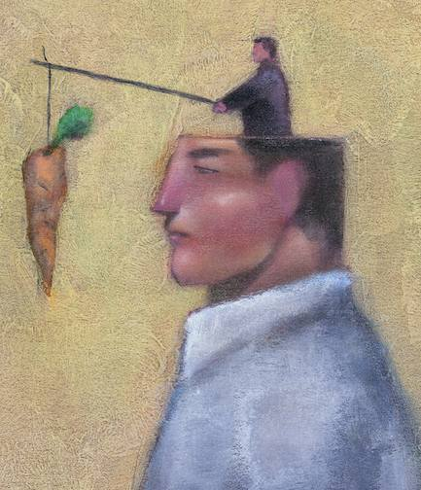
Four OB Mod Consequences
Positive reinforcement – when reinforcer (consequence) is introduced, the behavior is increased/maintained
Punishment – when introduced, the frequency or probability of the behavior decreases
Negative reinforcement –when this consequence is removed, behavior is increased/maintained
Extinction –behavior decreases when no consequence occurs

Slide 18
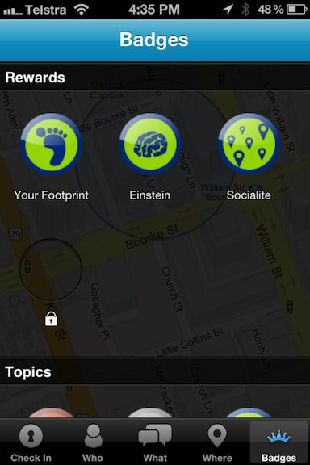
Reinforcing Behavior Through Gamification
Deloitte Touche Tohmatsu employees earn “badges” for documenting meetings and completing online learning modules. Earned badges are posted on leader boards, which further motivates them through friendly competition and status.

Slide 19
Social Cognitive Theory
Learning behavior outcomes
Observing consequences that others experience
Anticipate consequences in other situations
Behavior modeling
Observing and modeling behavior of others
Self-regulation
We engage in intentional, purposive action
We set goals, set standards, anticipate consequences
We reinforce our own behavior (self-reinforcement)

Slide 20
Effective Goal Setting Features
S
Specific – What, how, where, when, and with whom the task needs to be accomplished
Measurable – how much, how well, at what cost
Achievable – challenging, yet accepted (E-to-P)
Relevant – within employee’s control
Time-framed – due date and when assessed
Exciting – employee commitment, not just compliance
Reviewed – feedback and recognition on goal progress and accomplishment
M
A
R
T
E
R

Slide 21
Balanced Scorecard
Organizational-level goal setting and feedback
Usually financial, customer, internal, and learning/growth process goals
Several goals within each process

Slide 22
Characteristics of Effective Feedback
Specific – connected to goal details
Relevant – Relates to person’s behavior
Timely –links actions to outcomes
Credible – trustworthy source
Sufficiently frequent
Employee’s knowledge/experience
Task cycle

Slide 23
Sources of Feedback
Social sources -- feedback directly from others
e.g., boss, customers, multisource
Nonsocial sources -- feedback not conveyed directly by people
e.g., electronic displays, customer survey results
Preferred feedback source:
Nonsocial feedback for goal progress feedback
considered more accurate
negative feedback less damaging to self-esteem
Social sources for conveying positive feedback
Enhances employee’s self-esteem

Slide 24
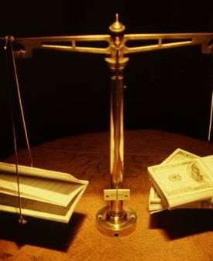
Organizational Justice
Distributive justice
Perceived fairness in outcomes we receive relative to our contributions and the outcomes and contributions of others
Procedural justice
Perceived fairness of the procedures used to decide the distribution of resources

Slide 25
Equity Theory
Your Own Outcome/Input Ratio
Comparison Other’s Outcome/Input Ratio
Own outcomes
Other’s outcomes
Compare own ratio with Other’s ratio
Own inputs
Other’s inputs
Perceptions of equity or inequity

Slide 26
Elements of Equity Theory
Outcome/input ratio
inputs -- what employee contributes (e.g., skill)
outcomes -- what employee receives (e.g., pay)
Comparison other
person/people whom we compare our ratio
not easily identifiable
Equity evaluation
Compare ratio with the comparison other

Slide 27
Correcting Inequity Tension
Actions to correct underreward inequity
Example
Reduce our inputs | Less organizational citizenship
Increase our outcomes | Ask for pay increase
Increase other’s inputs | Ask coworker to work harder
Reduce other’s outputs | Ask boss to stop giving preferred treatment to coworker
Change our perceptions | Start thinking that coworker’s perks aren’t really so valuable
Change comparison other | Compare self to someone closer to your situation
Leave the field | Quit job

Slide 28
Procedural Justice
Perceived fairness of procedures used to decide the distribution of resources
Higher procedural fairness with:
Voice
Unbiased decision maker
Decision based on all information
Existing policies consistently
Decision maker listened to all sides
Those who complain are treated respectfully
Those who complain are given full explanation

